Slide 1


SRI RAMAKRISHNA INSTITUTE OF TECHNOLOGY
(An Autonomous Institution)
Pachapalayam, Perur Chettipalayam, Coimbatore- 641 010
DEPARTMENT OF COMPUTER SCIENCE AND ENGINEERING
20CS902 - FYP Phase II
FIRST REVIEW BATCH NO : 39
ADDRESSING THE INCOME GAP CAUSED BY MIDDLEMEN IN AGRICULTURAL MARKETING THROUGH DIRECT FARMER-TO-CONSUMER SOLUTIONS
Presented by:
SANJAY S - 71382202130
SARUKESH A - 71382202134
SOORAJ R NAIR - 71382202152
VIGNESHWARAN S - 71382202173
Guided by:
MS A JAYASMRUTHI
Assistant Professor
Department of CSE

Slide 2
CONTENT OUTLINE
Abstract
Work Completed For Phase I
System Architecture
Use Case Diagram
Data Flow Diagram
Algorithms
40% Implementation
References

Slide 3
ABSTRACT
This project proposes a direct Farmer-to-Consumer digital platform to eliminate intermediaries and ensure fair pricing.
The system is developed using React.js (frontend), Node.js with Express (backend), and MongoDB (database).
Farmers can register, upload products, and sell directly, while consumers can view products and place orders through the platform.
The expected outcome is improved farmer income, transparent transactions, and better access to fresh produce for consumers.

Slide 4
WORK COMPLETED FOR PHASE I
Initialized the React application and designed basic UI components for farmer and consumer interaction
Set up the backend server and configured Express framework to handle RESTful API requests.
Designed MongoDB collections and schema for farmers, consumers, products, and orders.
Planned REST API endpoints and prepared Axios-based communication between frontend and backend.
Performed initial testing of UI forms and backend routes to verify correct data flow and error handling during development.

Slide 5
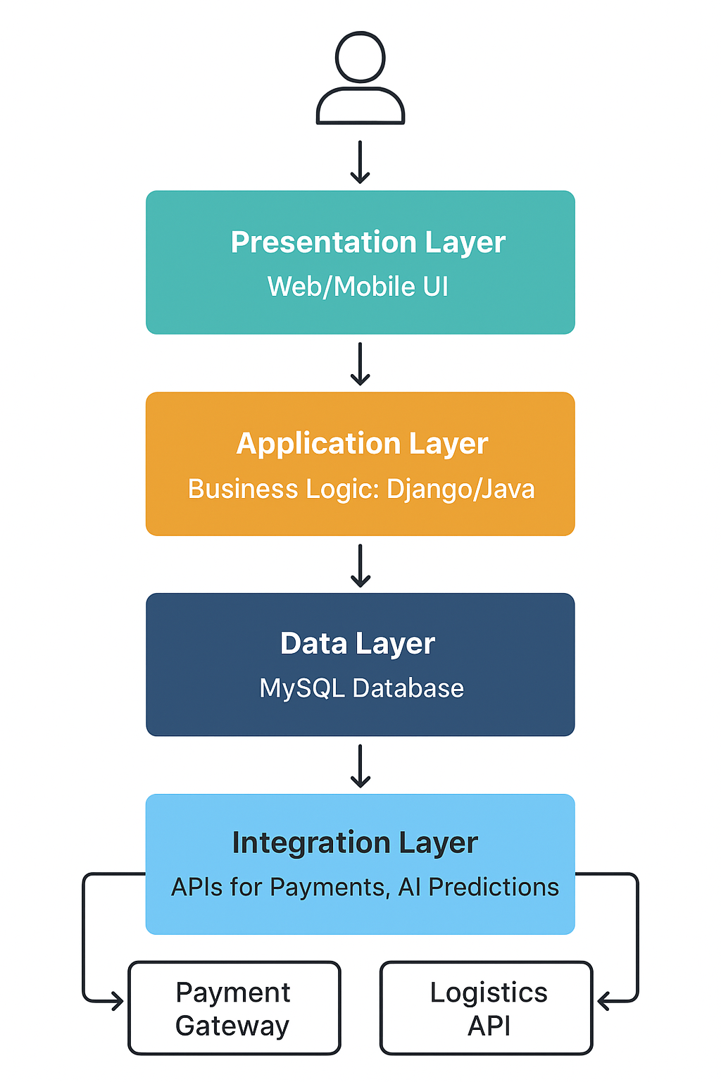
SYSTEM ARCHITECTURE

Slide 6
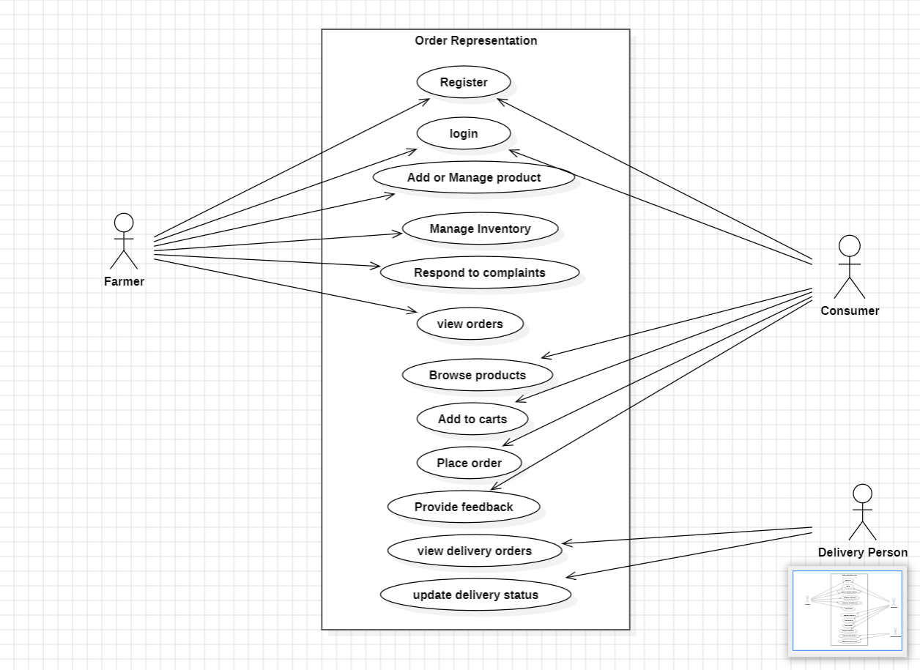
USE-CASE DIADRAM

Slide 7
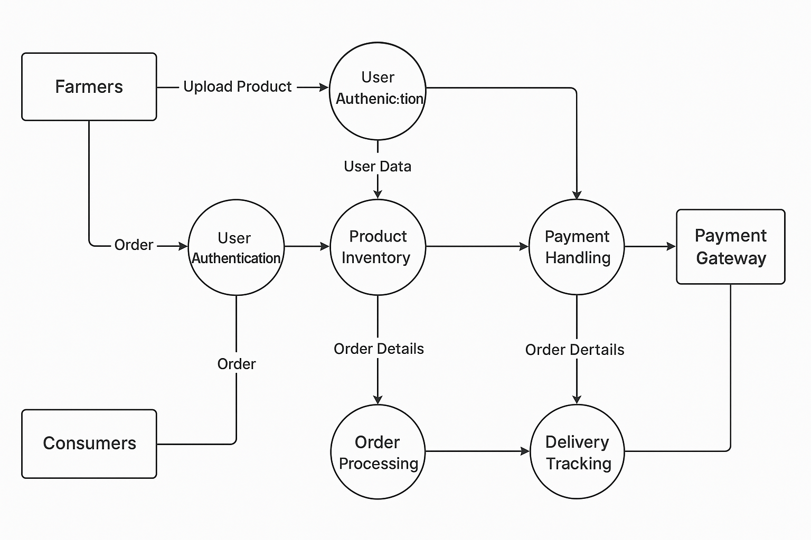
DATA FLOW DIAGRAM

Slide 8
ALOGRITHMS
Efficient Order Processing – Validates orders, updates inventory, and generates confirmations.
Smart Routing for Deliveries – Calculates optimal routes for farmers to distributors using shortest path logic
Real-Time Inventory Tracking – Monitors stock levels and triggers alerts for low inventory.
Automated Notification System – Sends timely updates on orders, deliveries, and inventory to users.
Secure Payment Verification – Confirms payments and updates order status with encryption for security.

Slide 9
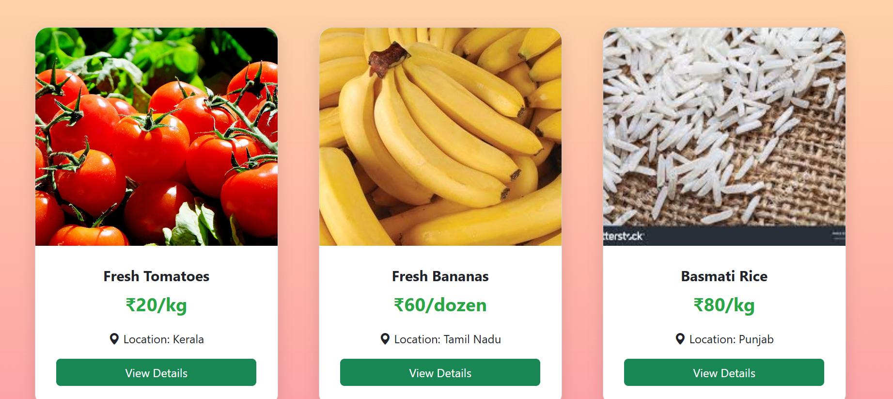
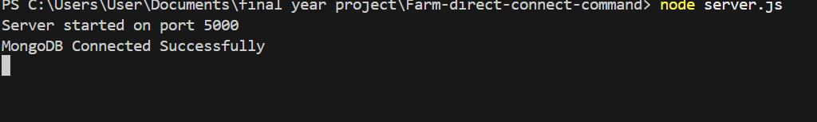
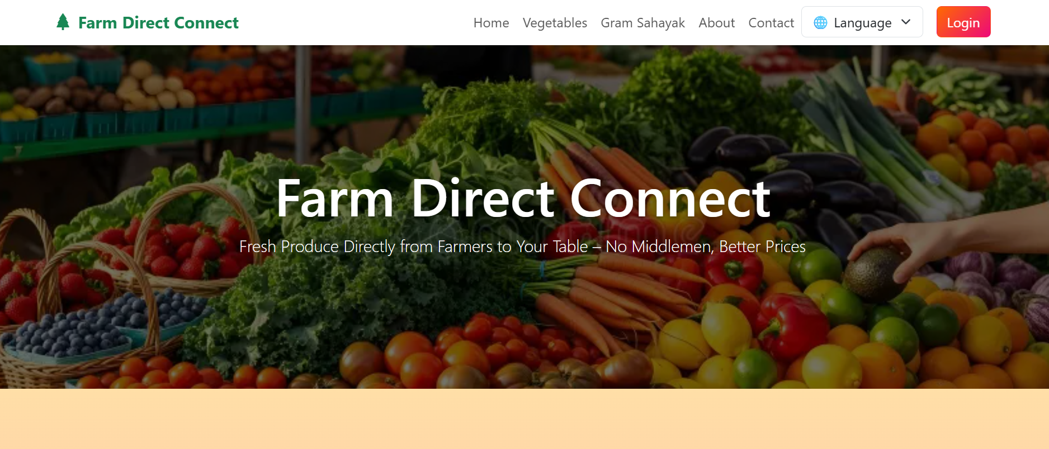

Slide 10
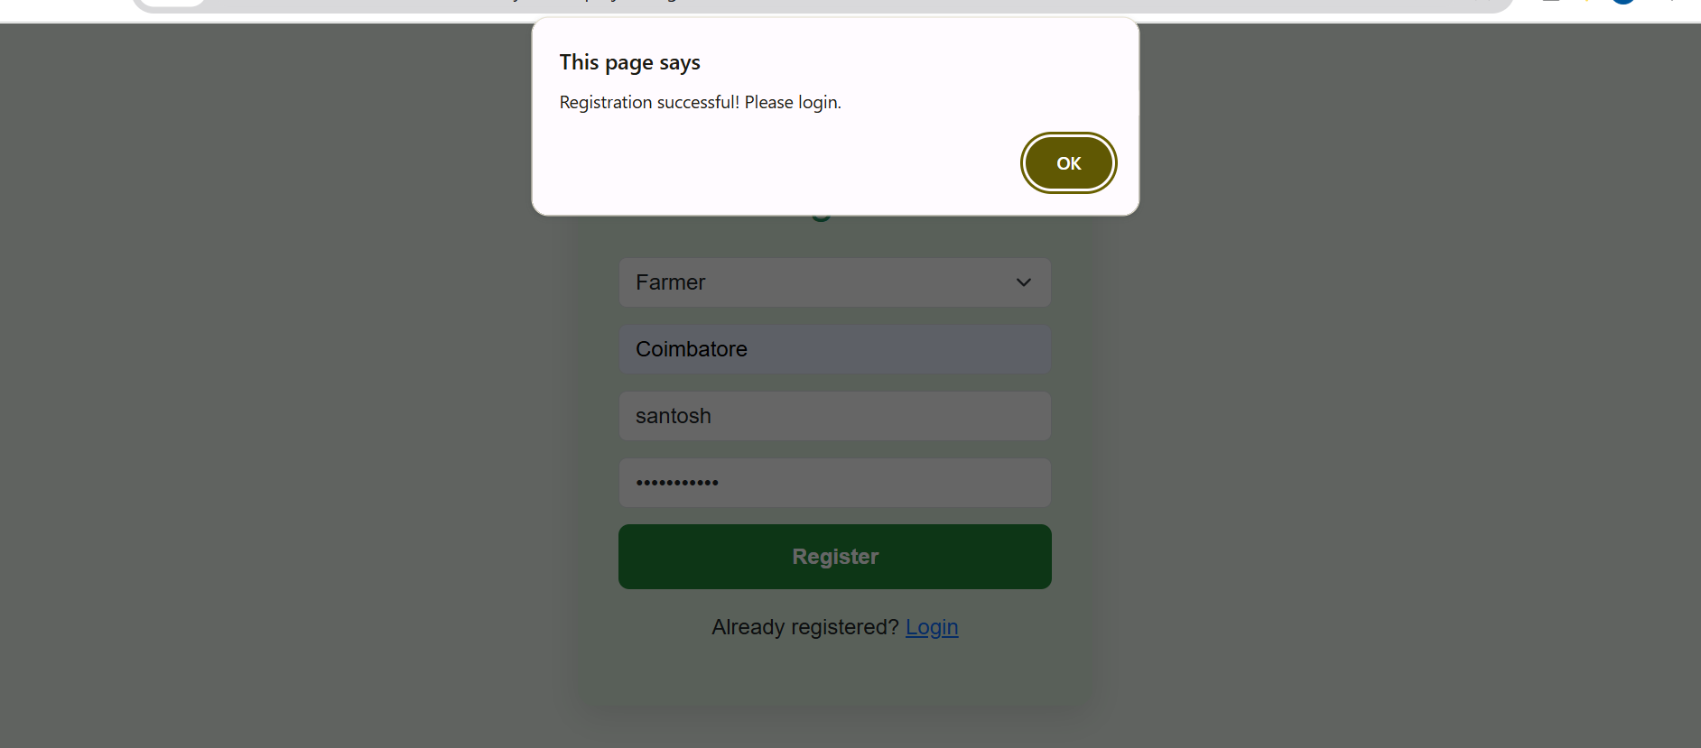

Slide 11
40% IMPLEMENTATION
Middlemen in traditional agricultural marketing reduce farmer profits by taking a large share of the consumer price.
Direct-to-consumer (D2C) web platforms help bridge this income gap by enabling farmers to sell directly to buyers.
The approach allows farmers to earn higher profits and build stronger, long-term relationships with consumers.
Simple digital tools like websites, mobile apps, and online payments give small farmers access to wider markets.
The project proved that a well-designed D2C system can increase farmer income by 10–30%.
Consumers also benefit by getting fresher produce at lower prices.
Overall, the system promotes transparency, fairness, and sustainability in agricultural marketing.

Slide 12
REFERENCES
D. S. V. Gowd, N. V. R. Reddy and K. Aravind, “Farmer To Consumer,” Conference Paper, Parul University, Mar. 2025.
P. Kushwaha, S. Mansoori, M. Patil, and R. Baheti “Transforming Agriculture: Enhancing Farmer-to-Consumer Connectivity Through Smart E-Commerce Platforms” Int. J. Sci. Res. Eng. Manag., vol. 9, no. 4, pp. 1–2, Apr. 2025.
A. S., A. S. V., M. M., and A. Jeyamurugan, “Web Based Application for Direct Market Access for Farmers,” Int. J. Creates. Thoughts, vol. 13, no. 4, pp. 192–197, Apr. 2025.
N. Anusha, P. S. Keerthi, M. R. Reddy, A. Ramesh, and M. R. Ignatious, “Farm to Home: An E-commerce Application for Farmers and Consumers,” in Advances in Computational Intelligence and its Applications, May 2024. DOI: 10.1201/9781003488682-5.
S. Uplaonkar and S. Biradar, “Middleman Growth in Agricultural Field and Its Impact on Farmers,” Int. J. Creat. Res. Thoughts, vol. 8, no. 3, pp. 3314–3317, Mar. 2020.

Slide 13
THANK YOU

